Slide 1
COSC3503 Operating Systems Chapter 13 I/O Systems
Doug Lim

Slide 2
Overview
I/O management is a major component of operating system design and operation
Important aspect of computer operation
I/O devices vary greatly
Various methods to control them
Performance management
New types of devices frequent
Ports, busses, device controllers connect to various devices
Device drivers software that encapsulate device details
Present uniform device-access interface to I/O subsystem

Slide 3
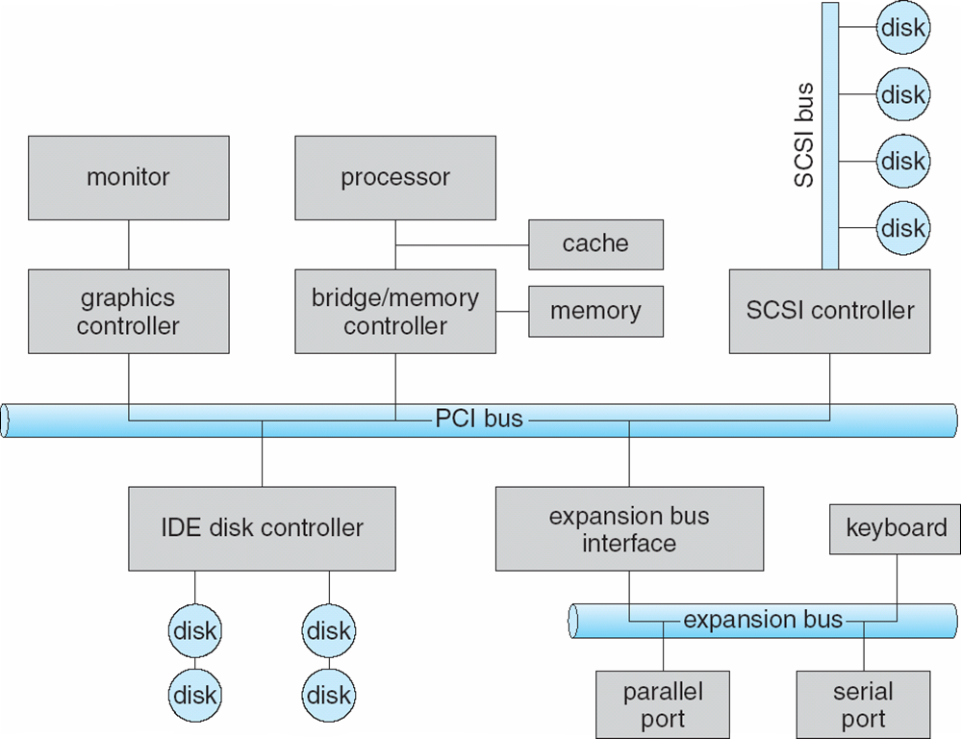
I/O Hardware
Incredible variety of I/O devices
Storage
Transmission
Human-interface
Common concepts – signals from I/O devices interface with computer
Port – connection point for device
Bus - daisy chain or shared direct access
PCI bus common in PCs and servers, PCI Express (PCIe)
expansion bus connects relatively slow devices
Controller (host adapter) – electronics that operate port, bus, device
Sometimes integrated
Sometimes separate circuit board (host adapter)
Contains processor, microcode, private memory, bus controller, etc
Some talk to per-device controller with bus controller, microcode, memory, etc

Slide 4
I/O Hardware Control
I/O instructions control devices
Devices usually have registers where device driver places commands, addresses, and data to write, or read data from registers after command execution
Data-in register, data-out register, status register, control register
Typically 1-4 bytes, or FIFO buffer
Devices have addresses, used by
Direct I/O instructions
Memory-mapped I/O
Device data and command registers mapped to processor address space
Especially for large address spaces (graphics)

Slide 5
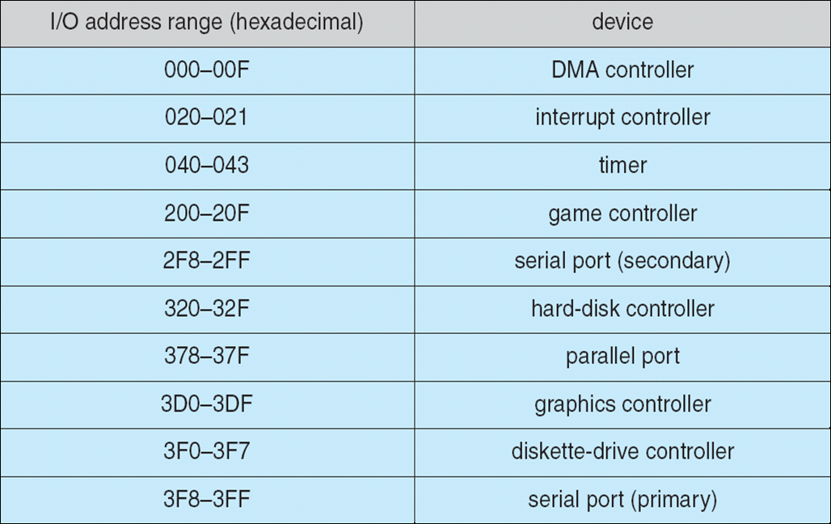
Device I/O Port Locations on PCs (partial)

Slide 6
Polling
For each byte of I/O
Host reads busy bit from status register until 0
Host sets read or write bit and if write copies data into data-out register
Host sets command-ready bit
Controller sets busy bit, executes transfer
Controller clears busy bit, error bit, command-ready bit when transfer done
Step 1 is busy-wait cycle to wait for I/O from device
Reasonable if device is fast
But inefficient if device slow
CPU switches to other tasks?
But if miss a cycle data overwritten / lost

Slide 7
Interrupts
Polling can happen in 3 instruction cycles
Read status, logical-and to extract status bit, branch if not zero
How to be more efficient if non-zero infrequently?
CPU Interrupt-request line triggered by I/O device
Checked by processor after each instruction
Interrupt handler receives interrupts
Maskable to ignore or delay some interrupts
Interrupt vector to dispatch interrupt to correct handler
Context switch at start and end
Based on priority
Some nonmaskable
Interrupt chaining if more than one device at same interrupt number

Slide 8
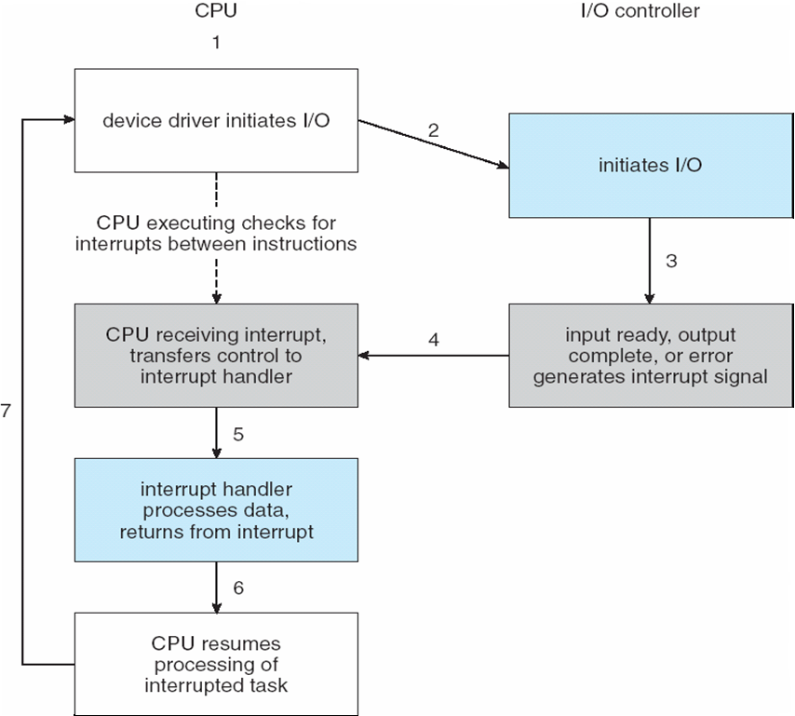
Interrupt-Driven I/O Cycle

Slide 9
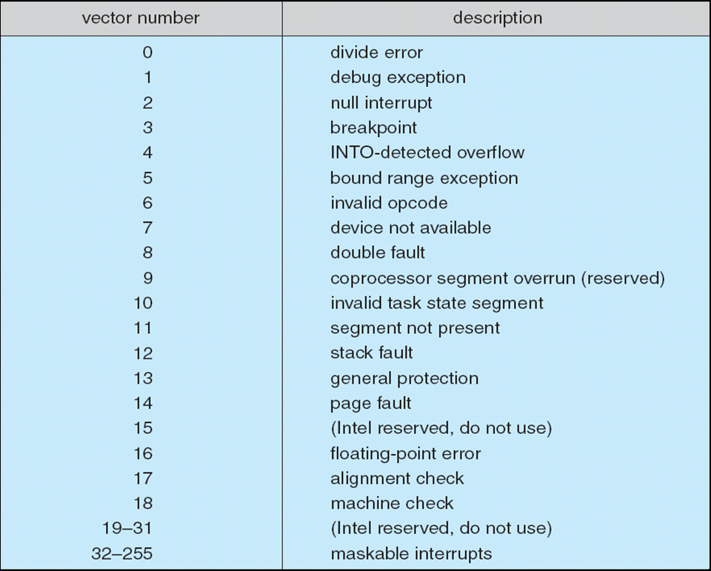
Intel Pentium Processor Event-Vector Table

Slide 10
More on Interrupts
Interrupt mechanism also used for exceptions
Terminate process, crash system due to hardware error
Page fault executes when memory access error
System call executes via trap to trigger kernel to execute request
Multi-CPU systems can process interrupts concurrently
If operating system designed to handle it
Used for time-sensitive processing, frequent, must be fast

Slide 11
Direct Memory Access
Used to avoid programmed I/O (one byte at a time) for large data movement
Requires DMA controller
Bypasses CPU to transfer data directly between I/O device and memory
OS writes DMA command block into memory
Source and destination addresses
Read or write mode
Count of bytes
Writes location of command block to DMA controller
Bus mastering of DMA controller – grabs bus from CPU
Cycle stealing from CPU but still much more efficient
When done, interrupts to signal completion
Version that is aware of virtual addresses can be even more efficient - DVMA

Slide 12
Six Step Process to Perform DMA Transfer

Slide 13
Application I/O Interface
I/O system calls encapsulate device behaviors in generic classes
Device-driver layer hides differences among I/O controllers from kernel
New devices talking already-implemented protocols need no extra work
Each OS has its own I/O subsystem structures and device driver frameworks
Devices vary in many dimensions
Character-stream or block
Sequential or random-access
Synchronous or asynchronous (or both)
Sharable or dedicated
Speed of operation
read-write, read only, or write only

Slide 14
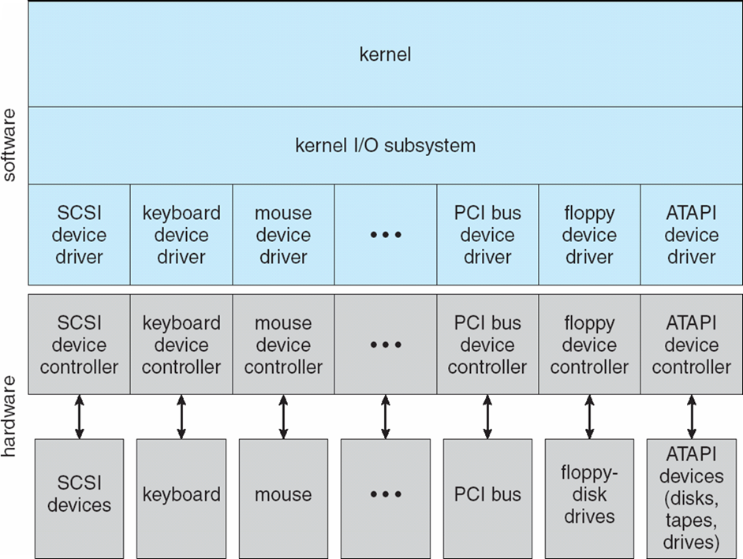
A Kernel I/O Structure

Slide 15
Characteristics of I/O Devices
Subtleties of devices handled by device drivers
Broadly I/O devices can be grouped by the OS into
Block I/O
Character I/O (Stream)
Memory-mapped file access
Network sockets
For direct manipulation of I/O device specific characteristics, usually an escape / back door
Unix ioctl() call to send arbitrary bits to a device control register and data to device data register

Slide 16
Block and Character Devices
Block devices include disk drives
Commands include read, write, seek
Raw I/O, direct I/O, or file-system access
Memory-mapped file access possible
File mapped to virtual memory and clusters brought via demand paging
DMA
Character devices include keyboards, mice, serial ports
Commands include get(), put()
Libraries layered on top allow line editing

Slide 17
Network Devices
Varying enough from block and character to have own interface
Linux, Unix, Windows and many others include socket interface
Separates network protocol from network operation
Includes select() functionality
Approaches vary widely (pipes, FIFOs, streams, queues, mailboxes)

Slide 18
Nonblocking and Asynchronous I/O
Blocking - process suspended until I/O completed
Easy to use and understand
Insufficient for some needs
Nonblocking - I/O call returns as much as available
User interface, data copy (buffered I/O)
Implemented via multi-threading
Returns quickly with count of bytes read or written
select() to find if data ready then read() or write() to transfer
Asynchronous - process runs while I/O executes
Difficult to use
I/O subsystem signals process when I/O completed

Slide 19
Kernel I/O Subsystem
Scheduling
Some I/O request ordering via per-device queue
Some OSs try fairness
Some implement Quality Of Service (i.e. IPQOS)
Buffering - store data in memory while transferring between devices
To cope with device speed mismatch
To cope with device transfer size mismatch
To maintain “copy semantics”
Double buffering – two copies of the data
Kernel and user
Varying sizes
Full / being processed and not-full / being used
Copy-on-write can be used for efficiency in some cases

Slide 20
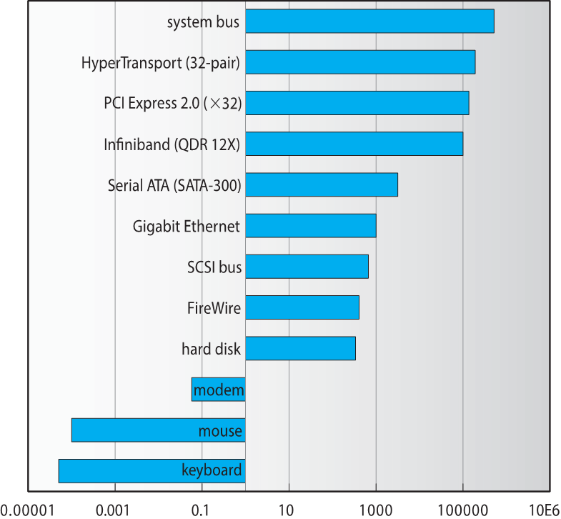
Sun Enterprise 6000 Device-Transfer Rates

Slide 21
Kernel I/O Subsystem
Caching - faster device holding copy of data
Always just a copy
Key to performance
Sometimes combined with buffering
Spooling - hold output for a device
If device can serve only one request at a time
i.e., Printing
Device reservation - provides exclusive access to a device
System calls for allocation and de-allocation
Watch out for deadlock

Slide 22
Error Handling
OS can recover from disk read, device unavailable, transient write failures
Retry a read or write, for example
Some systems more advanced – Solaris FMA, AIX
Track error frequencies, stop using device with increasing frequency of retry-able errors
Most return an error number or code when I/O request fails
System error logs hold problem reports

Slide 23
I/O Protection
User process may accidentally or purposefully attempt to disrupt normal operation via illegal I/O instructions
All I/O instructions defined to be privileged
I/O must be performed via system calls
Memory-mapped and I/O port memory locations must be protected too

Slide 24
Kernel Data Structures
Kernel keeps state info for I/O components, including open file tables, network connections, character device state
Many, many complex data structures to track buffers, memory allocation, “dirty” blocks
Some use object-oriented methods and message passing to implement I/O
Windows uses message passing
Message with I/O information passed from user mode into kernel
Message modified as it flows through to device driver and back to process
Pros / cons?
Unix I/O Kernel Structure

Slide 25
Power Management
Not strictly domain of I/O, but much is I/O related
Computers and devices use electricity, generate heat, frequently require cooling
OSes can help manage and improve use
Cloud computing environments move virtual machines between servers
Can end up evacuating whole systems and shutting them down
Mobile computing has power management as first class OS aspect

